Slide 1
Introduction to Movement Science Theory
Dr. Michelle Lussier PT5000

Slide 2

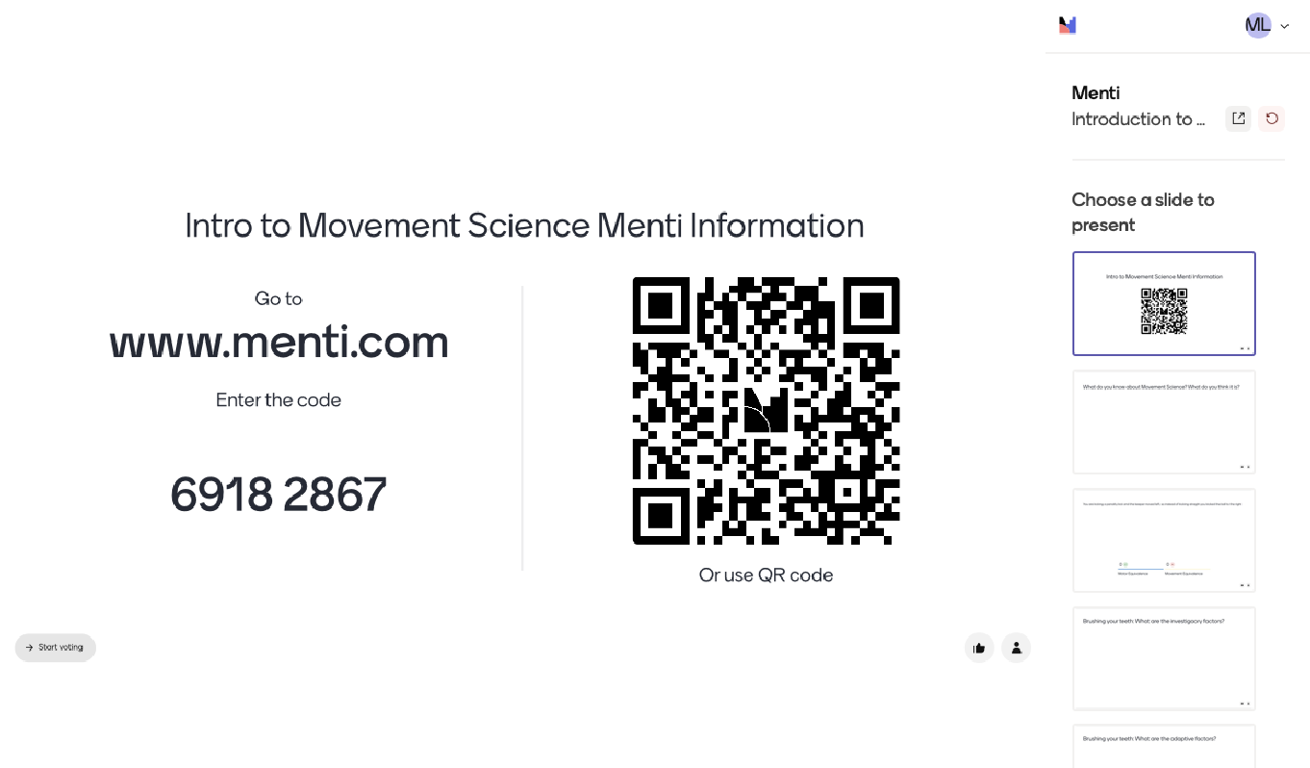

Slide 3
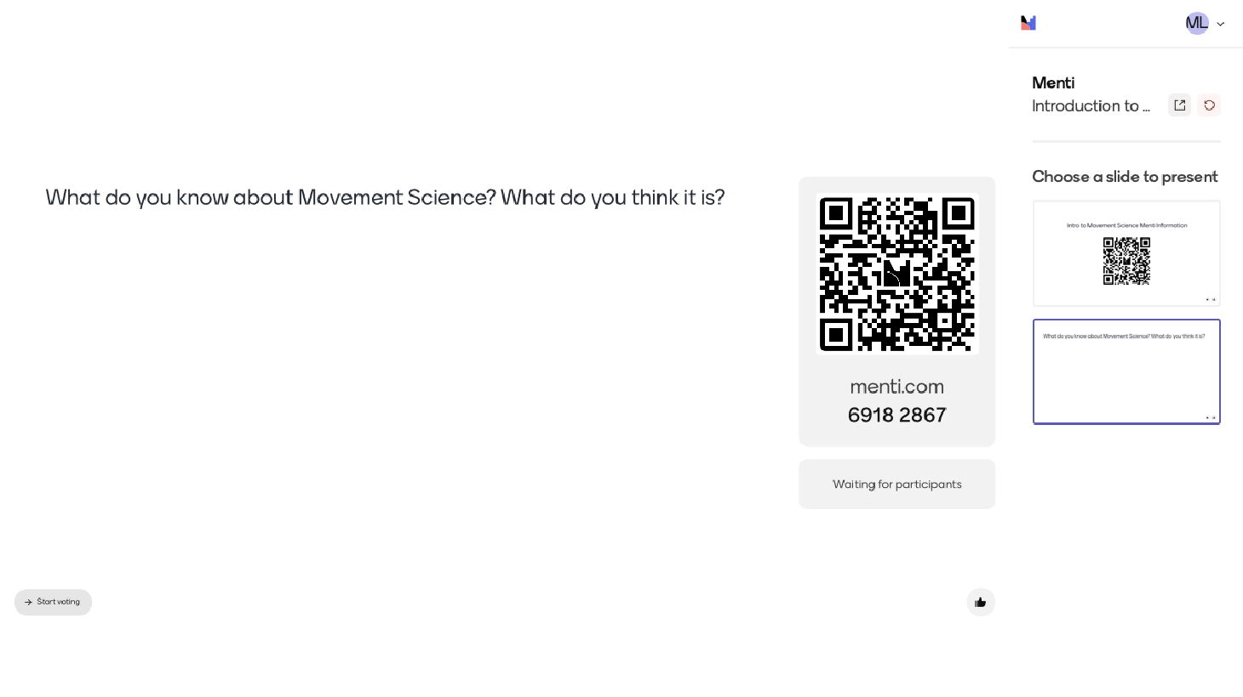

Slide 4

Tools Available to the Therapist
The Four Areas
Normal Motor Control Model
Motor Skill Acquisition
Variables affecting Practice and Learning (VAPAL)
Dyscontrol and Recovery of Function
VAPAL
Applying resistance or assistance
Modalities
Inhibitory pressure
Traction/compression
Vibration

Slide 5

What is Motor Control?
Motor Control – the ability to regulate or direct the mechanisms essential to movement
…helps us answer

Slide 6
What is Motor Control?
How does the central nervous system (CNS) organize the many individual muscles and joints into coordinated functional movements?
How is sensory information from the environment and the body used to select and control movement?
How do our perceptions of ourselves, the tasks we perform, and the environment in which we are moving influence our movement behaviour?
What is the best way to study movement, and how can movement problems be quantified in patients with motor control problems?
(Shumway-Cook, 3)
Motor Control – the ability to regulate or direct the mechanisms essential to movement
...helps us answer

Slide 7
Motor Control
Movement emerges from the interaction of 3 factors:
Individual
Task
Environment
Movement is organized around both task and environmental demands. The individual generates movement to meet the demands of the task being performed within a specific environment.
Motor Control includes perception and action systems that are organized to achieve specific goals or intents. This the study of motor control must include the study of cognitive processes as they relate to perception and action
(Shumway-Cook, 3)

Slide 8
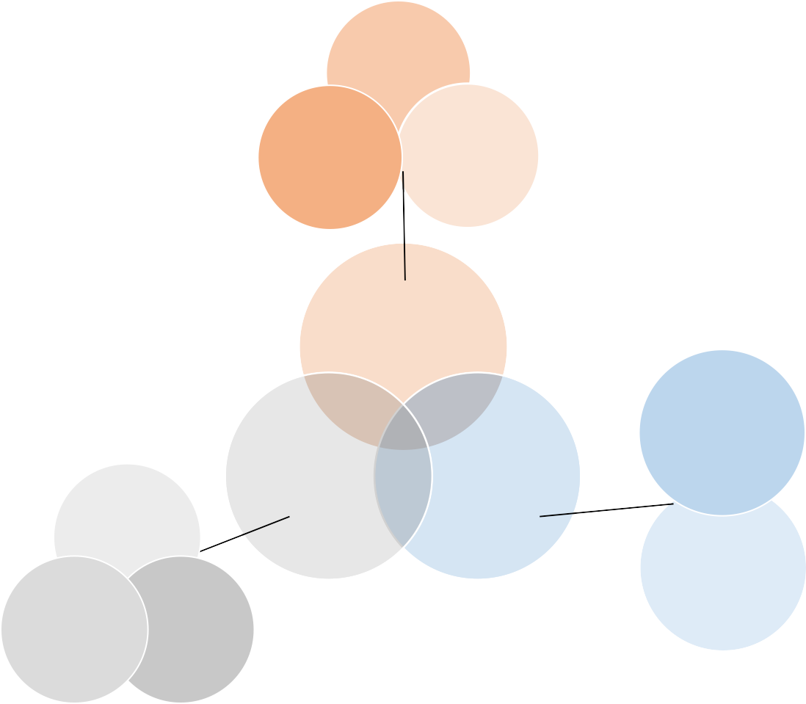
Motor Control
Mobility
‘’Factors within the individual, the task, and the environment affect the organization of movement. Factors within the individual include the interaction of perception, cognition, and action (motor) systems.
Environmental constraints on movement are divided into regulatory and nonregulatory factors. Finally, attributes of the task contribute to the organization of functional movement.”
Stability
Manipulation
Task
Regulatory
Individual
Environment
Cognitive
Non- Regulatory
Perception
Action
(Shumway-Cook, 5)

Slide 9

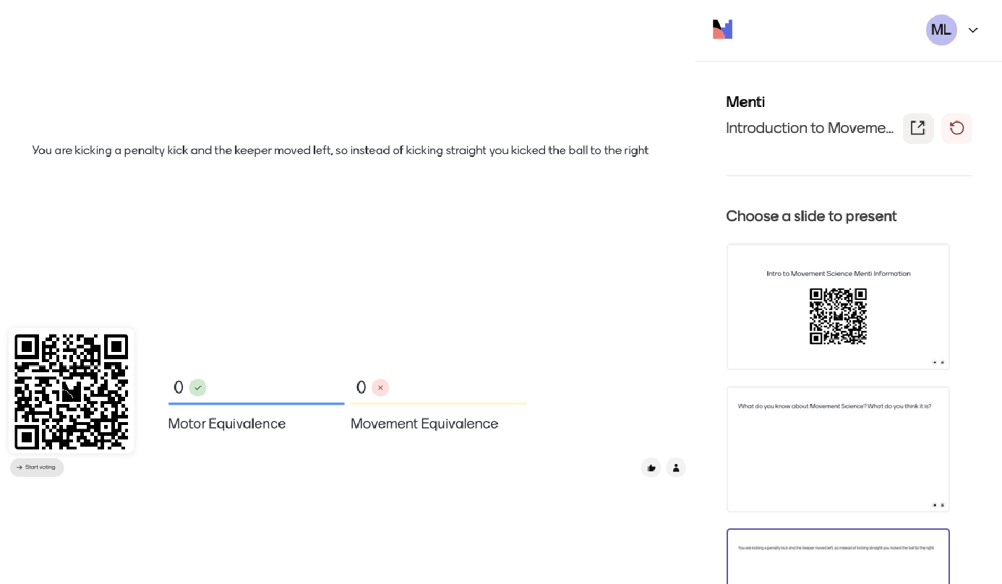

Slide 10
Motor Control
Human behavior is goal driven:
Accomplish intentional activities
Everything that you do is done to accomplish intentional activities/actions
If the intention is not there, you look confused

Slide 11
Motor Control
1. Investigatory
2. Adaptive
Pick up information from the environment; orient, focus, adjust our sensory analyzers to gather information
We use our sensory analyzers to pick out
very important information in the environment – like gathering supplies
Example: when going to make dinner, you go into the kitchen, you gather the supplies that you need and use sensory analyzers to look for and find what you need
Ex – when crossing the street (investigatory), feel the wind, listen for cars, etc
Interact directly with the physical or social environment
Once you have information, adaptive behavior kicks in because this is the behavior that interacts with the physical or social environment
Ex - The actual act of crossing the street or the act of avoiding things in the street
(Shumway-Cook, 3)

Slide 12


Slide 13
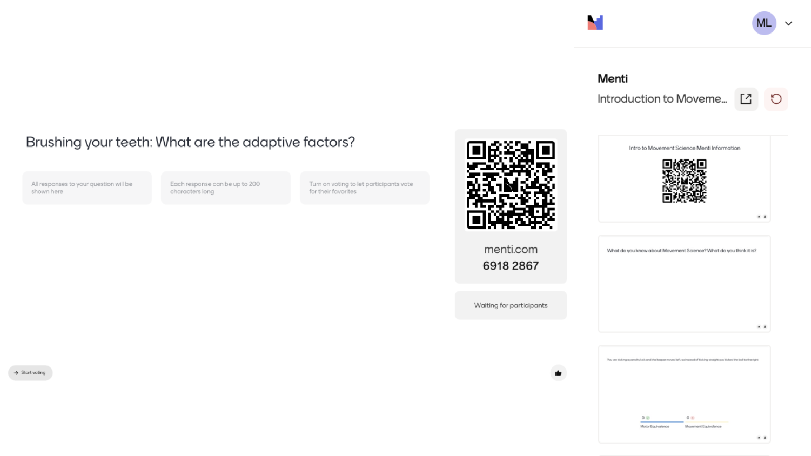

Slide 14
Using Motor Control to Analyze Behavior
Action (Behavior or Task)
  That is the actual outside/end of what you did
  Action: change in state from initial to final conditions (not how the change has occurred)
  Not how the change occurred, but it is what occurred
  OT and PT functional goals fit very nicely in an action because they say what is done, can be successful
Action
(what)

Slide 15
Using Motor Control to Analyze Behavior
Action
(what)
2. Movement (Biomechanical)
Strategies, patterns, path
Form (topology) and detailed sequence of components (joint motion, muscles, joints, torques, EMG)
Movement
(how)

Slide 16
Using Motor Control to Analyze Behavior
Neuromotor Processes
  Look at organization of the action on the basis of which brain areas are working, which tracts, whether it is at the brain or spinal cord level, which peripheral nerves are being utilized
  Organizational mechanisms in the CNS that constrain and sequence the movements
  Usually use inference to depict what is happening here because we see inside head
Action
(what)
Movement
(how)
Neuromotor Processes
(sensory and motor neurons needed)

Slide 17
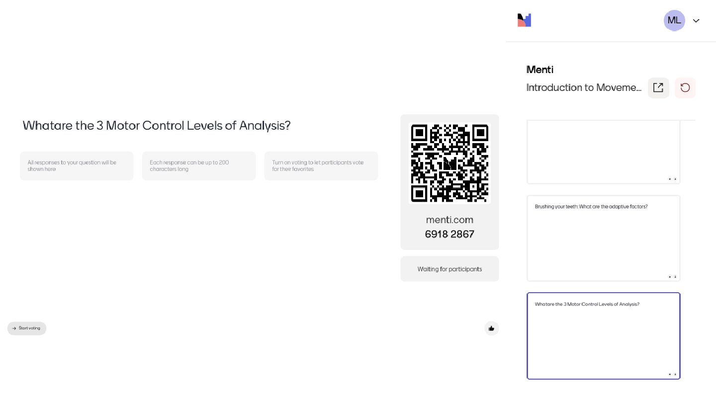

Slide 18
Using Motor Control to Analyze Behavior –
Relationship between levels is not 1:1
Action
(what)
Movement
(how)
Neuromotor Processes
(sensory and motor neurons needed)

Slide 19
Using Motor Control to Analyze Behavior –
Relationship between levels is not 1:1
How to you write with a pen?
Option 1: https://www.youtube.com/watch?v=9Ldwr2LLAos (start at 1:07)
Option 2: https://www.youtube.com/watch?v=Va1InskEgsc
Option 3: https://www.youtube.com/watch?v=mlMQw6xMn6k

Slide 20
Using Motor Control to Analyze Behavior
Action can drive the movement
Action can drive the neuromotor processes
Many movement patterns which can produce the same outcome
Movement equivalence is changing the way you MOVE to accomplish the same task
Motor Equivalence is changing the NEUROMOTOR PROCESSES you use to accomplish the same task

Slide 21

Using Motor Control to Analyze Behavior
Motor Equivalence vs Movement Equivalence

Slide 22


Part 2 – Skill Acquisition

Slide 23
Skilled Action
Competence
Consistency & Economy
Effective Use of Resources
Relative to the Individual
Task Specific

Slide 24
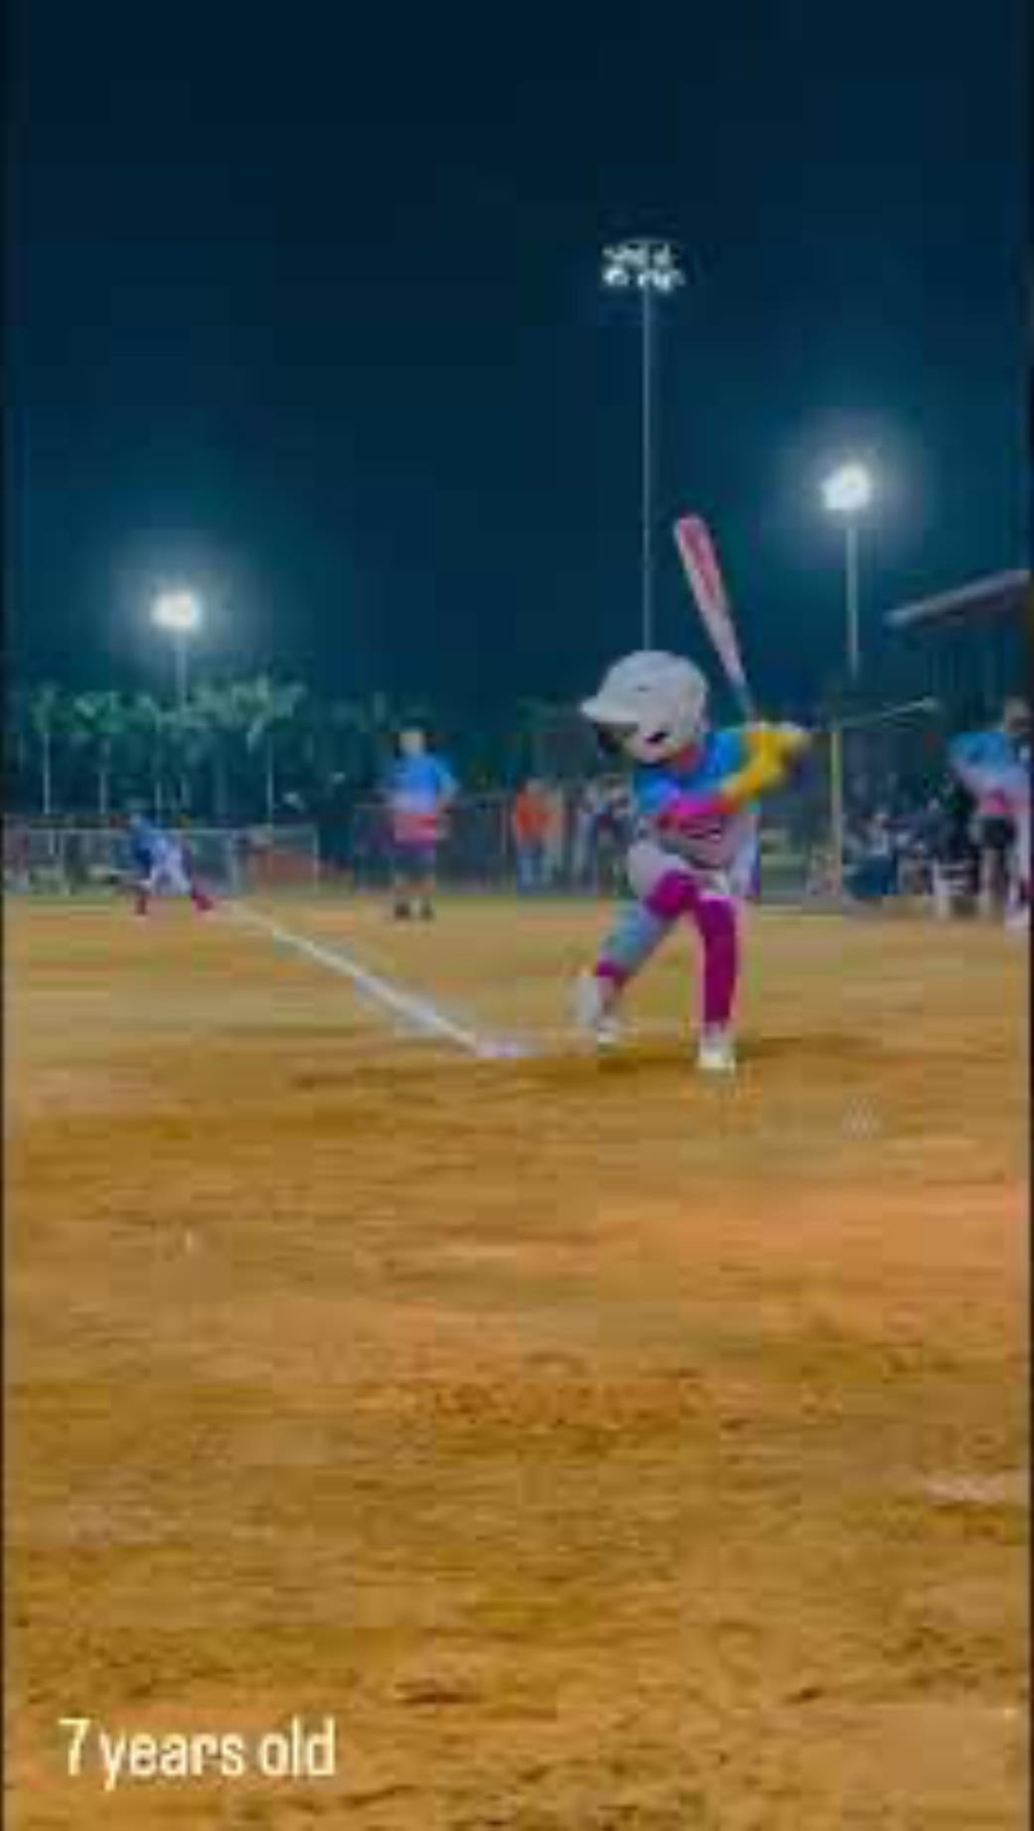
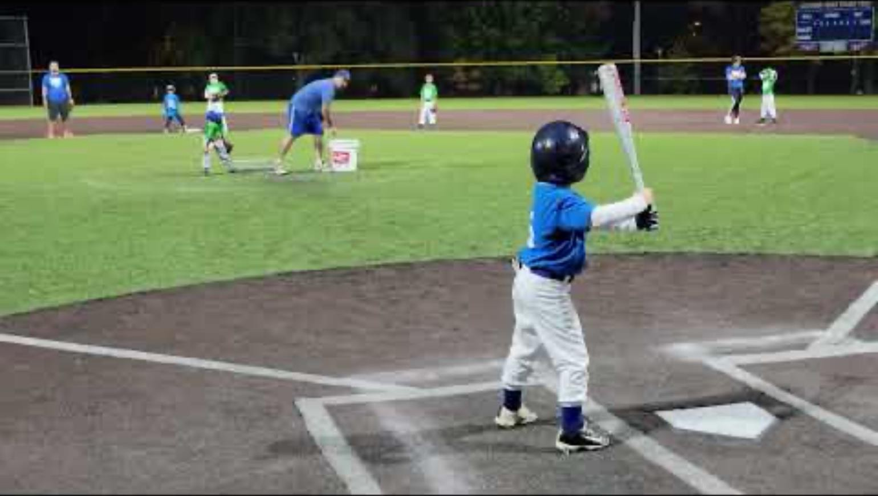

Skilled Action

Slide 25
Skill Acquisition
Skill - Consistency in attaining the goal with some economy of effort
Competence – When someone has a skill
Consistency - Able to repeat something (motor skill) with small changed in standard deviation
Economy of effort - Low energy demand (O2/CO2 ratio, rate of perceived exertion, baseline and change in heart rate, time it takes to do something)

Slide 26
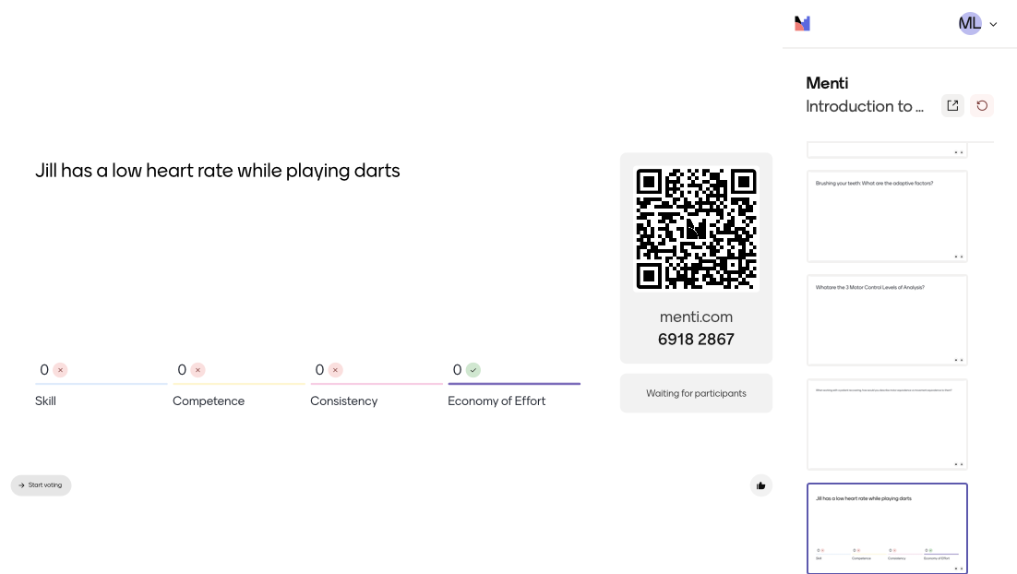
Jill has a low heart rate while playing darts

Slide 27
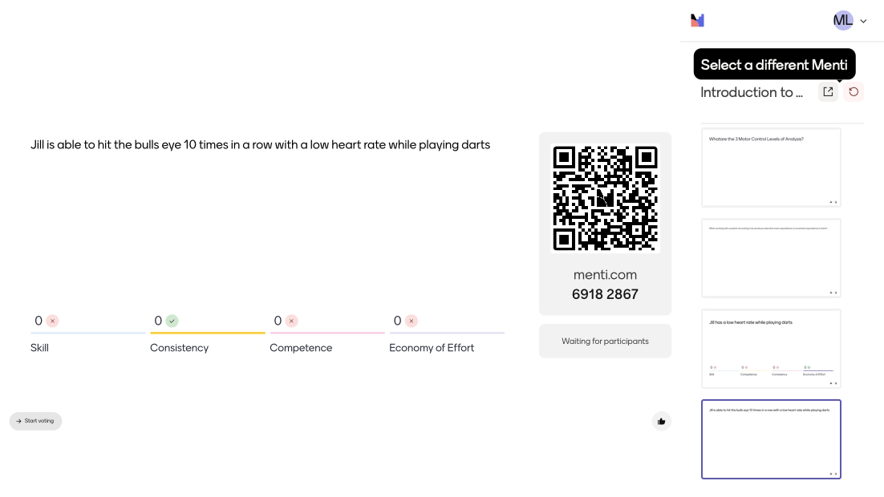
Jill is able to hit the bulls eye 10 times in a row with a low heart rate while playing darts

Slide 28



Skilled Action

Slide 29
Motor Theories
Some theories:
Motor Programming Theory
Systems Theory
Ecological Theory
Current Theory used by Physical Therapists & Physiotherapist:
Dynamical System Theory –
  Movement results from many systems interacting (constraining) to yield the most stable pattern
  Subsystems self-organize
  Subsystems organize at different rates
“Movement is possible in the absence of reflexive action. Sensory input, while not essential in driving movement, has an important function in modulating action.” (Shumway-Cook, 11)

Slide 30
Skill Acquisition:
Learning
Learning - defined as a relatively permanent change
Motor Learning – the study of the acquisition and/or modification of movement.
While motor control focuses on understanding the control of movement already acquired, motor learning focuses on understanding the acquisition and/or modification of movement
Performance - temporary change in motor behavior seen during practice sessions
True learning - measured when you stop doing the activity, you go away, and you come back (retained learning)
For example, Mrs. Jean J shows an improved ability to stand symmetrically (with weight evenly distributed to both legs) at the end of her daily therapy session, but when she returns to therapy the following day, she again stands with all her weight on her noninvolved leg. This suggests that while performance had improved in response to therapy, learning had not yet occurred. When on subsequent days Mrs. J demonstrates a more symmetric weight-bearing stance even as she arrives for therapy, we may suggest that learning (a permanent change in behavior) is occurring.
(Shumway-Cook, 21-22)

Slide 31
Motivation
Skill Acquisition:
Factors that Affect Learning
Arousal
Attention
Memory

Slide 32
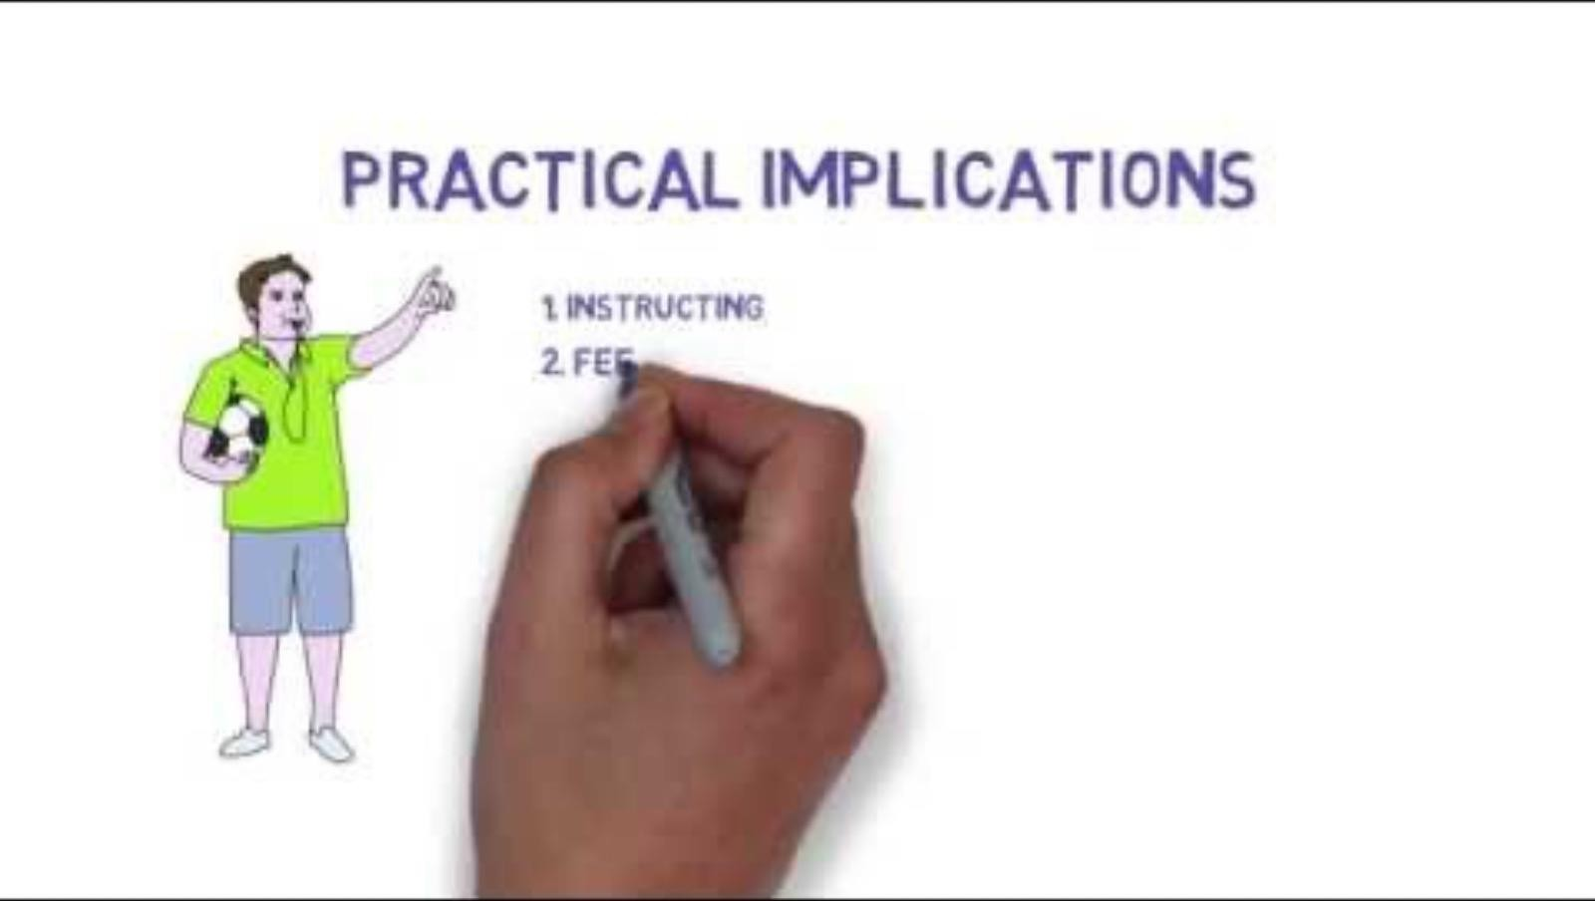
Does attention affect Motor Learning vs Motor Performance? YES

Slide 33
Improving Neuromuscular Control using Task Specific Practice
Improving performance should be specific to what should be achieved
Mechanisms underlying training motor control- neuroplasticity & motor learning
Implementing Neuroplasticity motor control programmes | Applying motor learning principles to motor control programmes
Meaningful activities e.g. sit to stand to get to toilet, to get food, to go out | High Intensity Practice: within and outside practice
High Intensity: 3 – 4 times a week, at least 2 hours per day crucial | Feedback: intrinsic & extrinsic feedback
High repetition: 300 reps for upper limb and 2000 steps for lower limb | Practice conditions: modification of practice elements to enable task to be performed
Task specificity: acquisition of skills required and not anatomical movements | Focus of attention: paying attention to interaction with objects rather than movements is more meaningful
Challenge: task must involve dual tasking and/or multi- tasking | Instructions: modelling or verbal instructions
Variation and Timing: arrange task to start from various starting position
19

Slide 34
Other Approaches
Technique | Uses
Hydrotherapy | Improved ability to move in water
Gymnastic balls | To support patient, train balance
Proprioceptive Neuromuscular Facilitation | Promote muscle contraction
Treadmill training | Cardiorespiratory and repetitive mobility training
Balance training | Improve balance
Constrained induced movement training | Forced upper limb use
Cueing | Prompting movement
TENS | Pain Relief, muscle stimulation, spasticity relief
Neurodynamics | Promoting neural mobility
Orthoses | Promote function and support joints

Slide 35
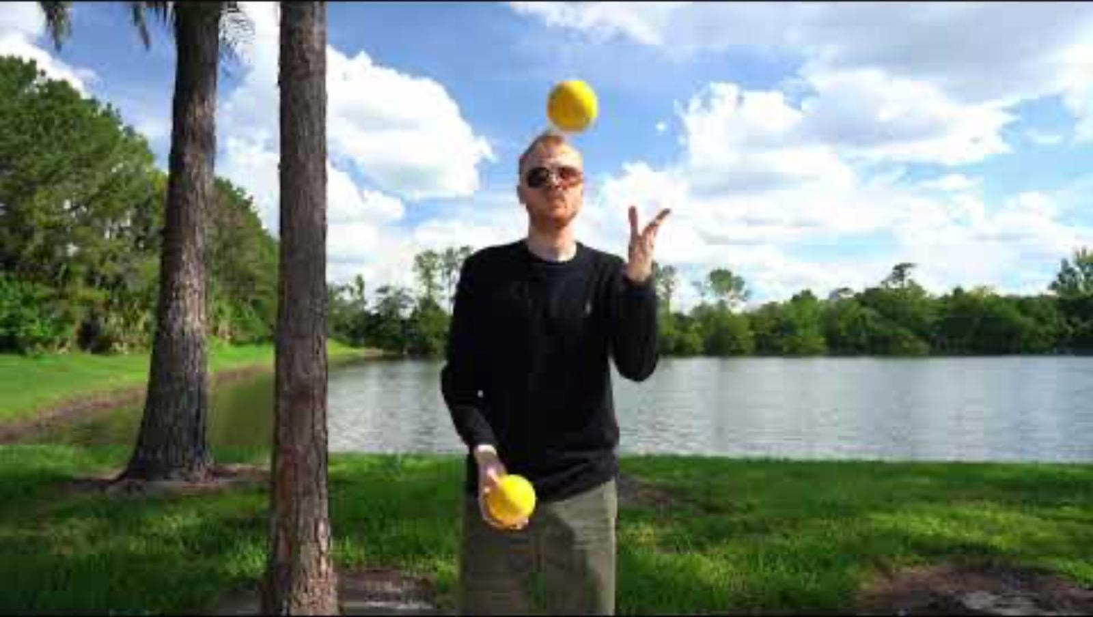
Put Motor Learning Into Practice!
Let’s practice teaching someone a skill!
... Like learning to juggle

Slide 36


Slide 37
References
Shumway-Cook, A. and Woollacott, M. H. (2023) Motor Control: Translating Research into Clinical Practice. 6th edn. Philadelphia: Wolters Kluwer.
Amirbekova, A., et al. (2025) 'Neuroplasticity-based physiotherapy approaches in stroke rehabilitation: a systematic review', Journal of Neurorehabilitation and Neural Repair, 39(8), pp. 612-628.
Additional Places to Look:
Schoenmaker, N., et al. (2024) 'OPTIMAL motor teaching strategies employed in physiotherapy for children with developmental coordination disorder: an observational study', Physical & Occupational Therapy In Pediatrics, 44(2), pp. 145-162.
Subramanian Durairaj, S., Sardesai, S. and Solomon, J.M. (2025) 'Motor learning principles reported in
stroke trials of upper limb task-oriented training: a scoping review', BMJ Open, 15(11), e12625.
Wulf, G. and Lewthwaite, R. (2025) Motor Learning and Performance: A Situational and Evidence-
Based Approach. 7th edn. Champaign, IL: Human Kinetics.
Zhang, L., et al. (2025) 'Effectiveness of motor relearning program in sit-to-stand transfer and activities of daily living among chronic stroke patients', Clinical Rehabilitation, 39(12), pp. 1580-1594.

